Slide 1
Effective assessment and feedback in a digital age

Slide 2
Outline of the day
Effective assessment and feedback
Explore your challenges and strengths with assessment and feedback
Introduce principles of effective assessment and feedback
Illustrate intervention points where technology can support the enhancement of assessment and feedback practices, through examples
Explore hands-on how you can use technology to deliver feedback, and what enhancements this could offer
We may not solve your challenges today, but we hope to offer ideas and resources which will enable conversations to continue within your contexts

Slide 3


Who we are
Tom Franklin, an independent learning technology consultant with over 15 years working in all areas of learning and learning technology
Sarah Davies, Jisc e-Learning Programme Manager with responsibility for digital literacies and assessment and feedback

Slide 4

Assessment and feedback: strengths and challenges
15 mins: Working in small groups
Discuss aspects of your assessment and feedback practice which you feel works well at the moment – what have you done that you feel is good or effective? Note them down on the green post-its
Then think about your ongoing challenges: what areas remain uppermost in your mind as challenges relating to assessment and feedback? Note them down on the pink post-its
15 mins: put your post-its on the wall and review those from other groups
What are the common issues?
Any good ideas?
Notes:
Go to ‘View’ menu > ‘Header and Footer…’ to edit the footers on this slide (click ‘Apply’ to change only the currently selected slide, or ‘Apply to All’ to change the footers on all slides.

Slide 5
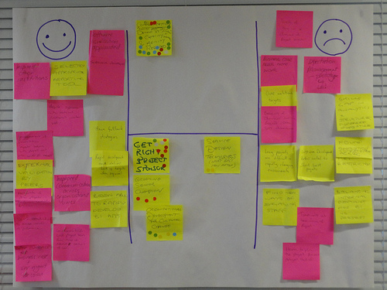
Assessment and feedback: strengths and challenges
http://www.jiscinfonet.ac.uk/infokits/participatory/production/identifying-issues/
Notes:
10 mins to now place your postits on the H form – strengths to the right, challenges to the left and any starting ideas for next steps below the goal post.

Slide 6
Why do we assess students?
Effective assessment and feedback
Whatever else it does, assessment should fundamentally be about building learners’ capacity to make informed judgments about their work. It always needs to do double duty - for immediate purposes and for the longer-term.’ David Boud

Slide 7
Key challenges identified by Jisc projects
Principles not reflected in strategy
Assessment doesn’t reflect working life
Essays and exams still predominate
Timeliness and quality of feedback
Modules inhibit longitudinal development

Slide 8
What is feedback? What’s it for?
Activity: in twos and threes, discuss:
Your definition of feedback
What is the purpose of giving feedback?
Notes:
“Feedback should help the student understand more about the learning goal, and more ways to bridge the gap between their current status and the desired status.”1
Feedback encapsulates:
1.Where am I going? (Goals)
2.How am I going/doing? (attainment)
3.Where to next? (or how do I get there?)2 (feedforward)
Feedback should develop the students’ capacity to make evaluative judgements about their own and others work1,8
Feedback should serve the function of progressively enabling students to better monitor, evaluate and regulate their own learning, independently of the
teacher7
“Feedback should be conceptualised as a dialogical and contingent two-way process that involves coordinated teacher–student and peer-to-peer interaction as well as active learner engagement.”5
1.Sadler, D. R. (2010) Beyond feedback: developing student capability in complex appraisal. Assessment & Evaluation in Higher Education, 35:5, 535-550.
2.Hattie, J. & Timperley, H. (2007). The Power of Feedback. Review of Educational Research, 77, 81-112.
3.Veloski, J., Boex, J. R., Grasberger, M. J., Evans, A., & Wolfson, D. B. (2006). Systematic review of the literature on assessment, feedback and physicians’ clinical performance*: BEME Guide No. 7. Medical Teacher, 28(2), 117-128.
4.Carless, D. (2006). Differing perceptions in the feedback process. Studies in Higher Education, 31(2), 219-233.
5.Nicol, D. (2010). From monologue to dialogue: improving written feedback processes in mass higher education. Assessment & Evaluation in Higher Education, 35(5), 501 - 517.
6.Sadler, D. R. (1989). Formative assessment and the design of instructional systems. Instructional Science, 18(2), 119-144.
7.Nicol, D. J., & Macfarlane‐Dick, D. (2006). Formative assessment and self‐regulated learning: a model and seven principles of good feedback practice. Studies in Higher Education, 31(2), 199-218.
8.Boud, D., & Associates. (2010). Assessment 2010: Seven propositions for assessment reform in higher education. Sydney: Australian Learning and Teaching Council.

Slide 9
What is important about feedback?
Widely recognised as a key component of effective learning. Good feedback practice should:
Clarify what good performance is
Facilitate self-assessment
Deliver high-quality feedback information
Encourage peer and teacher dialogue
Encourage positive motivation and self-esteem
Provide opportunities to close the gap (feed forward)
Provide information to improve teaching
(REAP project)
Despite this recognition and understanding of principles, it remains a challenge for many institutions
Notes:
Yet despite evidence of improved understanding of the importance of feedback, the Jisc Assessment and Feedback projects when setting out their aims indicate continuing concerns about the consistency and quality of feedback across the institution, a lack of strategic focus on formative assessment and feedback, and a need for more diverse approaches to feedback that offer efficiency as well as effectiveness.
Along with consistency (quality and quantity), the timeliness of feedback appears to be a key issue across the board. Many schools/departments do set deadlines for marking and the return of feedback but there remain issues with the overall assessment timetable and whether students receive feedback in time for it to be useful in preparing for the next assignment. Where this does occur there is substantial evidence that students do appreciate and act upon feedback. One project noted problems with illegibiity of written feedback.
The extent to which feedback supports the ongoing development of the individual learner by feeding forward into their future learning depends on the quality of the feedback given and whether it is developmental in nature rather than simply justifying a grade.
Go into meaning of term ‘feed forward’ – feedback that looks forward to next assignment, offering constructive guidance on how to do better in future work.

Slide 10


What are the challenges in giving feedback?
... And having it ‘heard’?
Notes:
Review challenges produced earlier by delegates in the strengths and challenges exercise – get people to give detail or add any more – ie SHORT DISCUSSION – as whole group of in twos and threes – what isn’t working and why, and what could they do to improve it?
Likely to include:
Time-consuming to produce good feedback
If it’s to be maximally useful, will be needed before next assignment
Maybe only have time to produce general feedback for whole cohort
Students only focus on the mark
- Students don’t bother picking it up – or don’t take any notice
- Tends to be most taken on board by mid-achieving students – those at either end may not act on it
Gaps in perception:
Tutors think they provide more detailed feedback than students perceive
Tutors view their feedback to be more useful compared to what students think
What of the person ‘receiving’ the feedback?
•Interplay between fear, confidence and reasoning in receptivity to feedback
•Tendency for ‘deflection’ when there is a discrepancy between learners’ internal perceptions (self-evaluation) and the external teacher’s perceptions (feedback)
•Learner re-interprets the external feedback to make it conform with their own hope, intention or interpretation of their performance
•Perceived credibility of feedback giver essential
Commonly reported concerns of students
•Feedback is too late to influence learning
•Feedback is cryptic e.g. “more”
•Feedback provides no explanation for action e.g. “good”
•Good students miss out
•Feedback is “one off” – no chance to try again based on the feedback

Slide 11
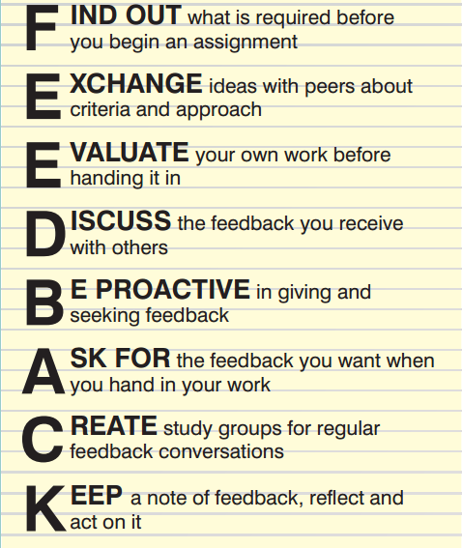
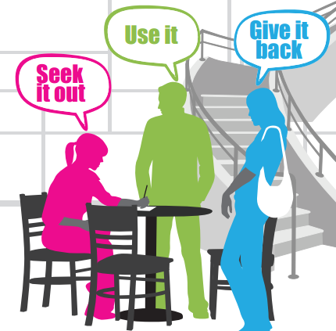
Strathclyde: feedback is a dialogue campaign
Notes:
Combined information for students with information for staff – presented as two sides of the same principles-based feedback coin. Students were encouraged to engage with the criteria and evaluate their own work – part of them understanding their own responsibilities with respect to feedback practice.
Staff were given examples of good assessment and feedback practice from different curriculum areas.

Slide 12
Examples of effective feedback practice
Self-assess or peer comments prior to submission
Review feedback with peers in tutorials
One-minute papers
Use face to face time for students to work through problems – feedback for when they’re stuck
Link comments to previously stated criteria
Point students to where they can find the answer
Ask students to highlights areas they want comments on
Hold back grade until feedback digested
Ask students to identify useful comments
Get students to turn feedback into action points
University of Strathclyde
Notes:
Teacher-student feedback in class can also be facilitated through the use of in-class feedback techniques. One example described by Angelo and Cross (1990) is the ‘one-minute paper’. Students are asked for written short answers to two questions posed at the end of a lecture class. For example, ‘what was the key idea in today’s lesson?’ and ‘what question remains unanswered in your mind? They respond to these questions on paper and the teacher uses the results to provide feedback and to stimulate discussion at the next lecture session. This not only integrates feedback into teaching and learning processes but it also helps build a dialogue around learning in large classes.

Slide 13
Other approaches to feedback
Longitudinal assessment and feedback
When providing feedback on an assessment, consider the student’s previous ‘assessment career’
Helps to identify recurrent problems eg with assessment format, and persistent misconceptions
Supports effective feed forward
Ipsative assessment and feedback
Assessment and feedback based on comparison with previous performance
Focuses on improvement and gives credit for this regardless of achievement
Feedback on how far learner has travelled from previous level of performance
Notes:
A longitudinal view of assessment (as proposed by the Assessment Careers project in the Jisc Assessment and Feedback programme) reconceptualises assessment as a learning trajectory during which many opportunities for assessment have occurred, with both good and bad results from which important lessons can be learnt. For example, themes and patterns across the span of a learner’s progress are rarely if ever taken into account during feedback on new assignments, yet by taking a longitudinal approach, examination of earlier assignments might reveal that the same misconceptions or errors in approach have been repeated again and again.
Learners also bring with them to any new stage of learning attitudes and dispositions formed over a longer span of assessment experiences, some of which can act as unrecognised barriers to future progress which affect transition into a new level of learning - for example, interviews over one year with a sample of sixty students on Masters degree programmes at the Institute of Education, London, revealed that some forms of assessment, such as academic essays, were inhibiting some students’ transition into the postgraduate programmes. (Assessment Careers project, Institute of Education, London)
The potential disjunct between past and current assessment experiences becomes even more salient on modular undergraduate programmes where feedback given in different modules can vary in terms of focus, detail and approach, and feed forward is inconsistently supplied. The result is that learners give less attention to feedback and see it as less valuable than the grade awarded. A longitudinal view of learners’ progress measured against the feedback given on previous assignments combined with subsequent self-assessment would give more pertinent insight into a learner's progress than grades or feedback on separately marked assignments.
Ipsative assessment and feedback (assessment and feedback based on comparison with previous performance) focuses on improvement rather than grading against set assessment criteria. An approach commonly used in performance-related disciplines such as music or sport, ipsative assessment enables credit to be given for improvement regardless of achievement (Hughes, Okumoto and Crawford, 2010). Ipsative feedback in turn makes comments on how the learner has travelled from a previous level of performance, which is both more motivational for non-traditional learners and more likely to promote self-regulation.
In a wide range of assessment scenarios, from professional practice (medicine for example) to distance learning, ipsative assessment and feedback could reduce the need for testing and retesting of skills. Instead of ‘learning for the test’, a process of continuous monitoring and self-regulation can make the acquisition of professional or vocational competences more authentic, rewarding and genuine and enable tutors to devote more time and effort to mentoring.
Lessons learned from InterACT project:
Lessons learned:
Lessons learned in discussion with others are that they are worried about the time it takes and whether the dialogue continues forever. In our experience the majority of students only take 1 cycle and few do continue the conversation but this is not onerous. Despite the extra time for staff and students (about 5-10 minutes per assignment) they have found it valuable and worth this additional time.
Students value the opportunity to ask for specific feedback. They use this opportunity to ask for feedback about content, approach to the assignment, writing and referencing style, application to their own education practice and if anything is missing.
Students value the formal opportunity for assessment and feedback dialogue with the tutor.
Feedback dialogue is perceived by students and staff to add value to learning despite the small addition of time demands. However, efficiencies made by reducing the overall number of assessments may counter that additional time.
Redesigning the assessment taking into account the sequencing of the assignments has led to better feed forward opportunities. This can be seen in the first formative assessment that then leads to a summative assessment where the feedback provided has led to learning.
Students need to be better scaffolded in critically evaluating their own work.

Slide 14
Peer assessment and review: a win-win?
Learners take on role of appraisers
Can help them to:
engage more closely with assessment criteria
learn from one another
engage in dialogue about their decisions
understand the value of feedback
construct meanings of their own
develop attributes and skills that are valued in workplace
Needs to be carefully planned and handled

Slide 15
What are you giving feedback on?
How well the task is understood & performed
The processes needed to perform tasks/improve
Prompts to support self-directed improvement and reflection
Comments on the learner (‘well done!’)
By:
Identifying good/bad points with eg tick or underline
Categorising strengths/errors eg wrt criteria
Providing correction/example of strength
Explanation of correction/strength
Advice for future performance
Notes:
Activity: think of a couple of assignments you’ve given feedback on recently. How much of your feedback focussed on the bullets from each list? Was it different for different assignments? Different for stronger and weaker students? What else causes difference in feedback approach?

Slide 16
Technology-enhanced assessment and feedback

Slide 17


Technology-enhanced assessment and feedback
Brainstorm
What does technology-enhanced assessment and feedback mean to you?
Notes:
5 minute brainstorm on examples of use.
5 minutes feedback.

Slide 18
Technology-enhanced assessment and feedback
‘The wide range of ways in which technology can be used to support assessment and feedback.’
These technologies may be generic (such as VLEs, wikis, podcasts, e-portfolio systems) or purpose-built (such as on-screen assessment systems and tools to support peer review)
The focus is therefore broader than was has traditionally been described as e-assessment
‘Technology doesn’t solve everything but it enables me to do something about it’
Prof. Mark Russell, University of Hertfordshire
Notes:
E-assesssment traditionally has had a focus on computer assisted assessment.

Slide 19
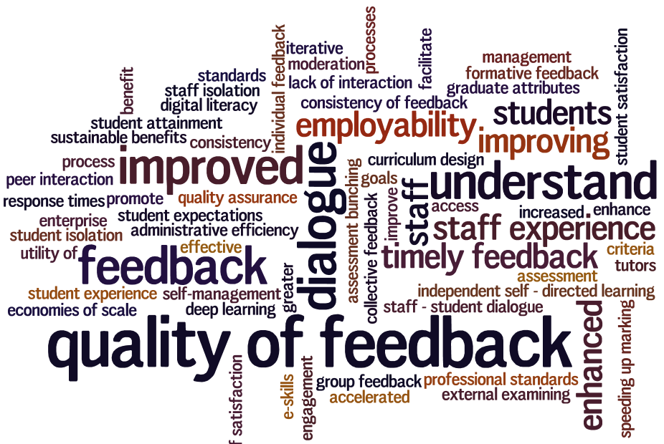
Technology to support......
Notes:
This is just a snapshot of the sort of issues that are looking to be addressed within the Jisc assessment and feedback programme, for example the quality, consistency and timeliness of feedback, enhancing dialogue around feedback, looking to better articulate graduate attributes etc. As you can see, feedback, and especially its quality, was the most frequently-cited issue in the programme

Slide 20
How can technology help with feedback practice?
Electronic voting systems – immediate feedback in lectures
Online computer-marked assessments (formative and summative) – immediate feedback.
Blogs and e-portfolios – reflection, can be shared for peer comments
Word-processed feedback eg comments in Word - legibility
Online submission and marking
Audio and video feedback
Notes:
The importance of learners engaging with their feedback has been strongly referenced in the literature (e.g David Boud’s work on closing the feedback loop, David Nicol). There is a perception that students don’t do this, which has been of real concern to academic staff. Evidence suggest that students doing this is likely to have a strong beneficial impact on student performance and achievement.
This issue has also been recognised as a result of poor results nationally for assessment and feedback in the National Students Survey (NSS), and so feedback has become the focus of campaigns (for example the NUS Feedback Amnesty (2008-2009) and the University of Strathclyde’s Feedback is a Dialogue), which draw on educational principles defining the nature of effective feedback. For example feedback should:
Clarify what good performance is
Facilitate self-assessment
Deliver high-quality feedback information
Encourage peer and teacher dialogue
Encourage positive motivation and self-esteem
Provide opportunities to close the gap
Use feedback to improve teaching
Feed forward is as important to learners’ progress as feedback. While feedback focuses on a learner’s current performance (and may simply justify the grade awarded), feed forward looks ahead to the next assignment, offering constructive guidance on how to do better in future work. A combination of the two ensures that assessment has an effective developmental impact on learning.

Slide 21
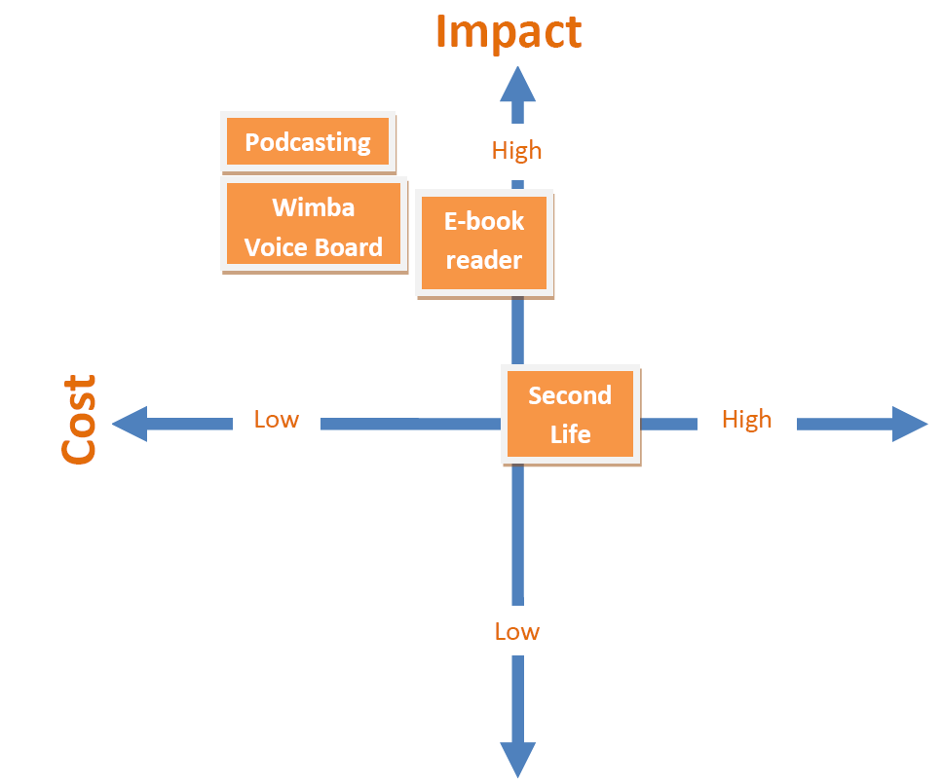
DUCKLING
Approach
Explored podcasts for
the delivery of feedback
Benefits
‘The results from the pilot action
research showed that podcasting
and voice board trials were the lowest
cost interventions with the highest
impact on the learning. They resulted
in a well-evidenced increase in learner
benefits in terms of personalisation,
flexibility, reduced isolation and
increased engagement, at a marginal cost in tutor time.’
Notes:
Attrition rates generally on distance learning courses tend to be higher than on campus-based courses so a team on the MSC Occupational Psychology course at Leicester explored using technology to ensure feedback was working as effectively as it could.
This team explored providing ‘feed forward’ and gaining better engagement with feedback through audio podcasts.
The experience of receiving audio feedback can be richer; tutors can expand on salient points, vary the tone, pitch and pace of the voice and add humour to build rapport and open the door to ongoing dialogue between tutor and learner. At the same time, there were felt to be efficiency gains for tutors, although to some extent these were experienced through the reduction of time spent in repeating key points which could be recorded for the benefit of all students.
EFFECTIVE ASSESSMENT IN A DIGITAL AGE WRITTEN CASE STUDY

Slide 22
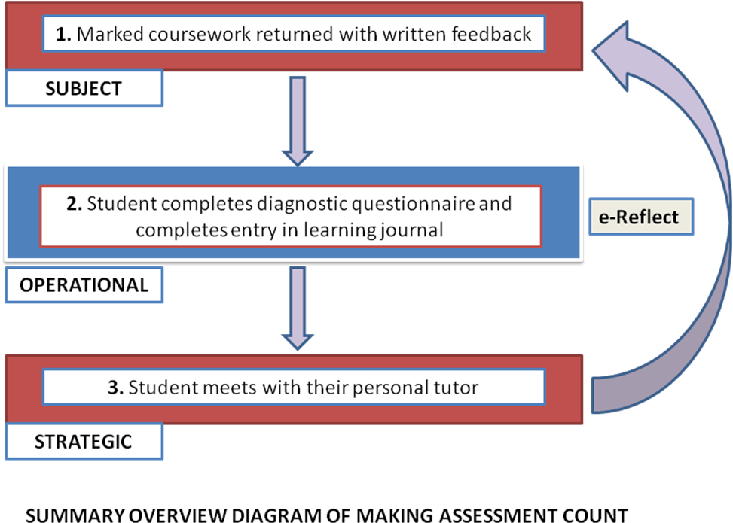
Making Assessment Count
Approach
Benefits
qualitative evidence
from students and staff
‘It has helped I think because since then my marks have shot up.”’
Notes:
To make feedback a more active experience for learners, the Making Assessment Count (MAC) project in the Curriculum Delivery programme developed the ‘e-Reflect’ process which utilised an online learning journal for student reflection on tutor feedback. The system enables feedback to become more active and personalised and joins up hitherto separate processes.
The MACE project is evaluating this process in a variety of different contexts. The process is being either supported through the VLE, through an e-portfolio, or using the eReflect tool developed by MAC.
VIDEO CASE STUDY (Effective Assessment in a Digital Age)

Slide 23
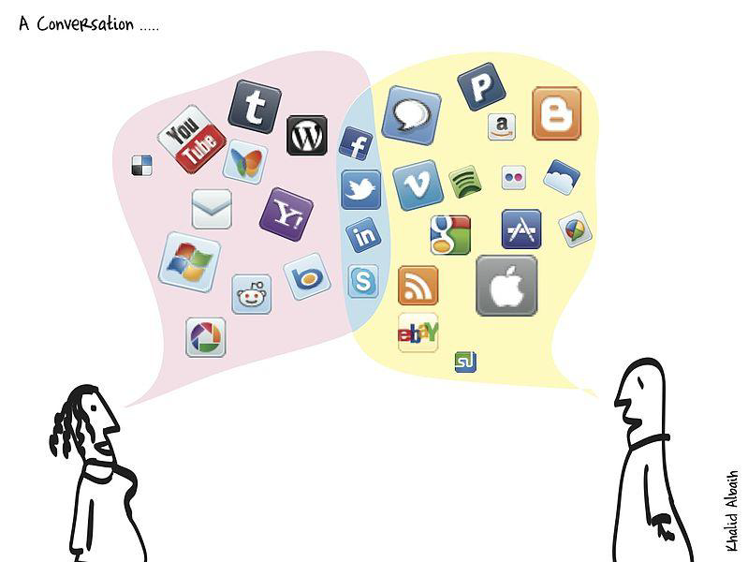
InterACT
Feedback is.........
http://www.flickr.com/photos/khalidalbaih/5653817859
Notes:
One way around the problem is to create regular opportunities for learners to reflect on how they have used feedback received on a previous assignment when working on the current one.
University of Dundee school of medicine deliver a purely online distance learning masters in medical education. So the tutors are delivering feedback, but weren’t clear the students were reading, understanding and acting on feedback.
They have redesigned the feedback process by adding a cover sheet to all assignments asking students to assess how well they feel they have delivered the learning outcomes, writing style, referencing, and what aspect they would like feedback on, and how they have acted on previous feedback.
Tutors mark the cover sheet and add comments. Students are then asked to reflect on their feedback in a wiki, and answer how well does the tutor feedback match the self evaluation, what have you learnt, what response will you make, and whether anything was unclear. Tutor continues the dialogue through the wiki.
So all assignments from different modules are stored in one place. Easy sharing and feedback processes, including external examiners. In addition to wikis, other technologies, such as e-portfolio systems could fulfill this role.
Lessons learned:
Lessons learned in discussion with others are that they are worried about the time it takes and whether the dialogue continues forever. In our experience the majority of students only take 1 cycle and few do continue the conversation but this is not onerous. Despite the extra time for staff and students (about 5-10 minutes per assignment) they have found it valuable and worth this additional time.
Students value the opportunity to ask for specific feedback. They use this opportunity to ask for feedback about content, approach to the assignment, writing and referencing style, application to their own education practice and if anything is missing.
Students value the formal opportunity for assessment and feedback dialogue with the tutor.
Feedback dialogue is perceived by students and staff to add value to learning despite the small addition of time demands. However, efficiencies made by reducing the overall number of assessments may counter that additional time.
Redesigning the assessment taking into account the sequencing of the assignments has led to better feed forward opportunities. This can be seen in the first formative assessment that then leads to a summative assessment where the feedback provided has led to learning.
Students need to be better scaffolded in critically evaluating their own work.

Slide 24

Evaluation of online submission and marking
Approach
EBEAM (Huddersfield) conducted an evaluation of the use of electronic assessment management strategies
Benefits
Students
‘There is strong evidence to suggest that not only is electronic assessment management their preference, but that they are very much of the mind that it is their entitlement’
EBEAM draft final report
Increased control and agency
Reduced anxiety
Improved privacy and security
Increased efficiency and convenience
Feedback which is clearer and easier to engage
with, understand and store for later use
Notes:
University of Huddersfield has been an early adopter of the Turnitin suite (including Grademark) over the last 5 years, and did an evaluation as part of our assessement and feedback programme.
They found there were many benefits to be had of electronic submission, the evidence pointed in nearly all cases to that.
‘for some reason they print them out and they hand you back like physical […] hard copy of all the notes’. This student’s use of the phrase ‘for some reason’ demonstrates a feeling of general bewilderment at this experiencewhich not only demonstrates how normal it had become for them to receive their feedback electronically, but also how illogical it seemed to them to receive on paper something which was clearly originally in electronic form.
Benefits to students
increased control and agency –
For some, reduced anxiety due to increasesed control, over when, and where they engaged with their feedback.
reduced anxiety – e.g clarity of knowing when they’d receive feedback and results reduced anxiety. Clarity of date of return. Also that clarity helped them to manage their time more effectively.
improved privacy and security – students were overwhelmingly confident in the process – so confident it hadn’t got lost, and that it had been securely submitted to the tutor and not visible to others. Liked the reciepting – fast and automated. As compared to dropping it in a box in a pile with others.Or feedback wasn’t given in a class setting when others ask what you got. Provided a sense of connection with the tutor, particularly for distance learners.
sig increased efficiency and convenience – all students reported added convenience. Inc reduction in time submitting work, ‘hassle’ eg fighting with printers just before the deadline, and flexibility in submitting it to fit round their lives. Liked a midnight submission as they could work up to it.
feedback which is clearer and easier to engage with, understand and store for later use – liked the clarity of date of return for their result and feedback (which related to a school policy). Reduced their anxiety knowing when. Also found it easier to read. Liked the way feedback worked in Grademark – inc bubble comments. Found that perceived lack of engagement with the feedback could also be related to the presentation of that feedback which students are finding hard to interpret – one student noted that having it online made it much easier to go back when doing another assignment and incorporate the feedback in as they went.
However, the research showed that there is a balance to be gained between giving staff flexibilty to come on board with e-marking when they are ready (which is key), and the strong entitlement students feel to it.
Recommended a system that is robust and secure, and allows for esubmission, but allows staff to mark in the way they prefer is likely to be the one that generates most benefits and least angst for the highest proportion of stakeholders.
It is likely a critical mass will be gained over time which should tip the balance with any reluctant staff.
Don’t recommend mandatory trianing for students, but should make available some self-paced online resources to support those that need it.
Findings largely confirmed by Glamorgan

Slide 25
Online marking and feedback – staff perspective
EBEAM (Huddersfield)
The online marking environment enabled:
Explicitly marking against the rubric
Use of a database of pre-composed comments to cover common errors
Simultaneous originality checking and marking
Teaching staff felt that this ‘cleared cognitive workbench’
Could spend more time engaging with what the student was saying and less time with how
Offers powerful potential with analytics
Glamorgan
Staff liked reduction in paper handling
Some felt online marking took longer – but were time savings elsewhere

Slide 26
Audio feedback
Reflections from audio feedback projects
All suggest students find benefits over written feedback, more personal, understandable, and clear. Students were more attentive. Although one found low performing learners prefer written (disputed elsewhere), and length can be an issue
One project found tutors found time took to be less or the same; another found all tutors struggled with the admin burden. One found the time taken was outweighed by the convenience of not repeating key points
Learners preferred some visual (asynchronous or synchronous) rather than audio alone
Type of audio feedback should be tailored to learner type and assessment type
Useful when combined with face-to-face follow up to ensure feed forward
Notes:
Delivering feedback in ways that enable learners to self correct, and that encourages dialogue is increasingly seen as key, but traditional feedback processes often fall short, and fail to engage learners.
AFAL – tutors found the administrative burden a downside (downloading anonymously and uploading through VLE BB). Sounds Good, found took less time or the same (audacity)
AFAL: 3 approaches to audio feedback: audio only (MP3), audio embedded in PDF (audiovisual asynchronous) and audio with screencasts (audiovisual syncronous) (Jing)
found Assessment type and learner type were the key variables:
Audio alone good for paper-based assessments (MP3)
Audio visual asynchronous good for reports and proposals (PDF)
Audio visual synchronous good for essays and presentations (Jing)
AFAL: Benefits to learners of audio feedback:
‘detailed’, ‘helpful’, ‘personal’ as opposed to ‘illegible’, ‘undetailed’, ‘short’, ‘impersonal’ but still ‘helpful’
Sounds Good – one pilot used 3 audio files, one to note common pitfalls, one on assessment framework, one on individual feedback. Followed up by a f2f.

Slide 27
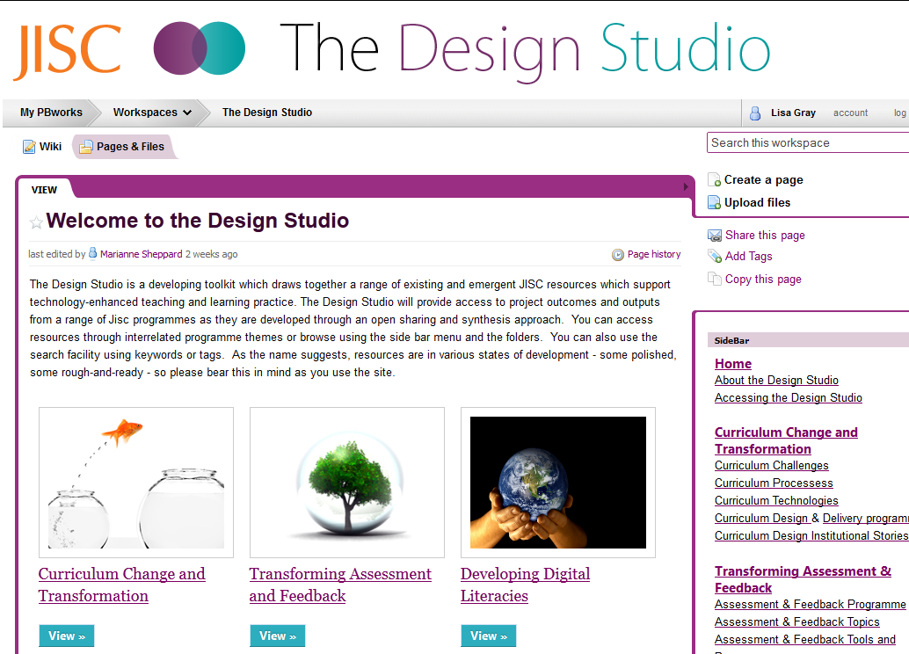
http://bit.ly/jiscdsaf
Notes:
A range of different types of tools, case studies, models, learning design, lessons learned etc which support teams in designing, developing and delivering curriculum in their institutions.
Topics include:
Assessment and employability
Assessment for learning
Assessment management
Authentic assessment
Feedback and Feed forward
Longitudinal and ipsative assessment
Peer assessment and review
Self-monitoring and self-evaluation
Work-based learning and assessment
Assessment and curriculum design
Assessment in strategy and policy
Balancing effectiveness and efficiency in assessment & feedback
Engaging stakeholders in assessment and feedback
Learner perspectives on assessment and feedback
Models of change in assessment and feedback
Processes supporting assessment and feedback
Wide-scale and cross institutional implementation

Slide 28





Follow us
#jiscassess
www.netvibes.com/jiscassess
Webinar series
bit.ly/afwebinars
elearning.jiscinvolve.org
www.youtube.com/jisccdd
Notes:
The JISC Assessment and Feedback programme is covering institutional change projects, evaluation activities and technical transfer projects. To find out more:
The programme has a range of channels for communication – using for example twitter around programme meetings and discussions; netvibes for collating project blogs; a programme blog and a YouTube channel for collating project videos.

Slide 29

© HEFCE 2012
The Higher Education Funding Council for England, on behalf of JISC, permits reuse of this presentation and its contents under the terms of the Creative Commons Attribution-Non-Commercial-No Derivative Works 2.0 UK England & Wales Licence.
http://creativecommons.org/licenses/by-nc-nd/2.0/uk
Notes:
Go to ‘View’ menu > ‘Header and Footer…’ to edit the footers on this slide (click ‘Apply’ to change only the currently selected slide, or ‘Apply to All’ to change the footers on all slides.

